Slide 1


Monkey See, Monkey Do
Volodymyr Orlov, Ivan Charkin
SMU MSDS 6306 Doing Data Science

Slide 2
Goal
Train a robot that learns to imitate a trader by looking only at a signal generated by his/her strategy.
Strategies employed by a trader are subject to following constrains:
A strategy should not get any other input except for daily stock/eft quotes.
A strategy followed by a trader should not change over time.

Slide 3
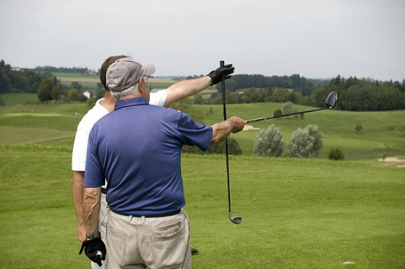
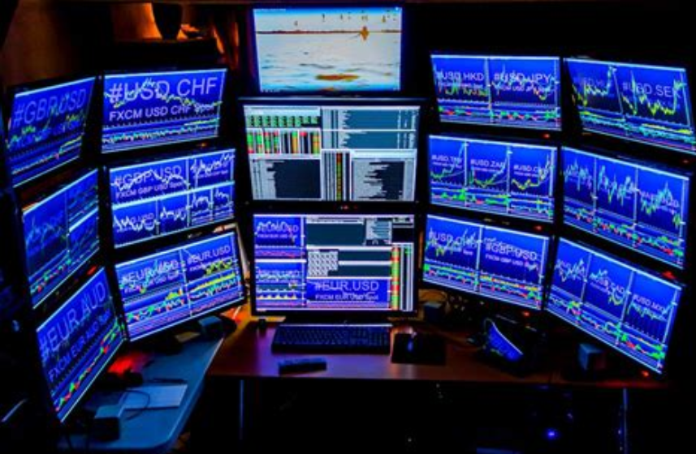

Background
Difference between traditional "investing" and "trading"
People doing investing research individual companies and make trading decisions based on news, company reports, golfing with people in the know, etc.
The technical traders base their decisions on the previous price pattern of the stock.
In turn the technical traders can be divided into two rough categories:
mathematical model traders - attempt to devise a mathematical model predicting stock behavior using oscillators, various indicators etc.
psychology traders - trying to predict emotions of traders who own or are considering trading the stock.
We are trying to emulate trading patters of a person not basing his decisions on mathematical models

Slide 4
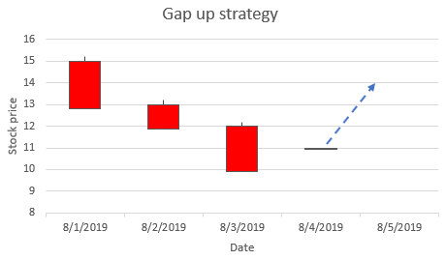
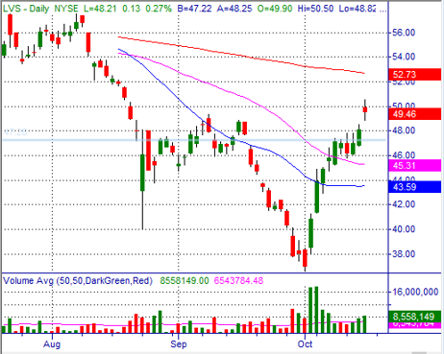
Example 1 - Gap up after downtrend
Stock which has been falling in price for multiple days.
Continuous selling of the stock likely depleted the ranks of the people who want to sell the stock and potentially attracted short sellers who sold the stock short in hopes of further falling prices.
One day after several days of falling prices the stock opens up at a higher value than the previous day close.
This event will potentially attract buyers who will anticipate reversal of the direction of the stock and will be attracted by relatively cheap prices. At the same time the short sellers may panic that the stock is going to go up which mean losing money and will start covering their positions (buying) driving the stock price even higher.

Slide 5
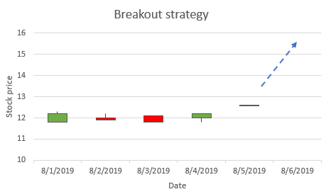
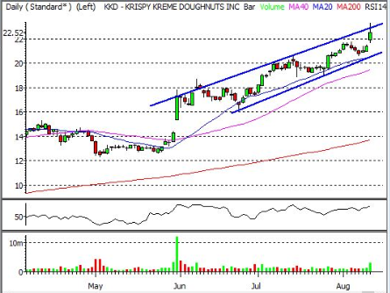
Example 2 - Breakout
If the price of a stock stays relatively flat for an extended period of time there is a higher probability of this stock to continue moving in the same direction after the stock price left the "flat" zone.
There are multiple underlying reasons for stocks staying at roughly the same price.
For example if the price of the stock reaches a round number such as 50, a lot of owners of the stock will be selling the stock because that is a round number they decided they were waiting for the stock to reach before selling it.
Even if there are many people willing to buy the stock, the pressure from the sellers will keep the stock down.

Slide 6
Data generation
As an input for teaching the robot real stock data from Yahoo Financial was used
Daily prices (Open, Close, High, Low) were collected for Dow 30 stocks
15 years of data were analyzed
Simple strategy described on previous slides were used to generate the BUY signal
Only Long trading was used (no Short selling)

Slide 7
Classification
{0, 1, 2}, a set of signals are labels, Y
Features are extracted from price at k previous days, X1, X2, X3 … Xk

Slide 8
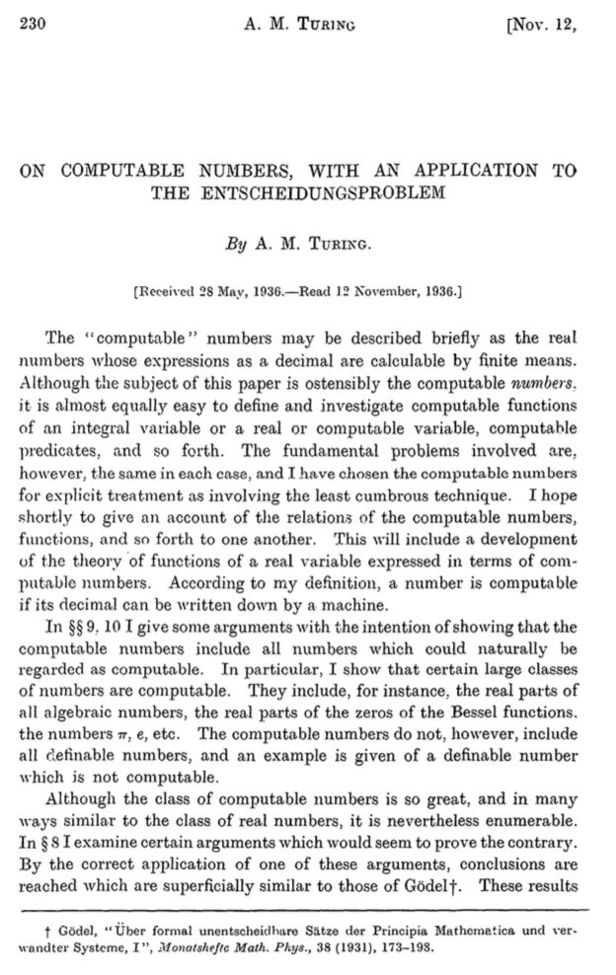
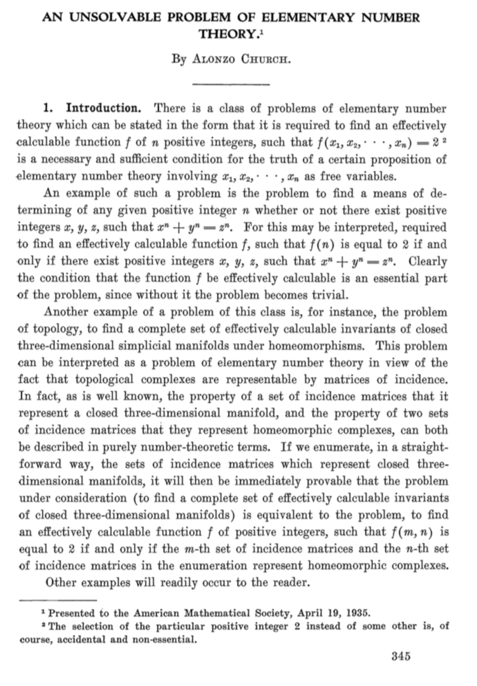
Universal Turing machine
A Turing machine is capable of simulating any computer algorithm.

Slide 9
Infinite monkey theorem
The infinite monkey theorem states that a monkey hitting keys at random on a typewriter keyboard for an infinite amount of time will almost surely type a given text, such as the complete works of William Shakespeare¹
¹https://en.wikipedia.org/wiki/Infinite_monkey_theorem

Slide 10
Infinite Monkey, v 2.0

Slide 11
Idea №1. Evolve Code for a Turing-complete Machine
Generate N Solutions
010100111011001
111011011101110
…
001100111011010
Evaluate
010100111011001→0.01
111011011101110→0.05
…
001100111011010→0.02
(2)
(1)
(3)
Select k < N
010100111011001→0.01✗
111011011101110→0.05✓
…
001100111011010→0.02✓
Evolve
111011011101110
X
001100111011010
=
001100111101110
(4)

Slide 12
Idea №2. FC-LSTM¹
Gradient-based method
Hard to train because search space is rugged and non-convex,
Input (60x4)
LSTM (16)
LSTM (32)
Dense (3)
Output (Buy/Sell/None)
¹ https://arxiv.org/pdf/1308.0850.pdf

Slide 13
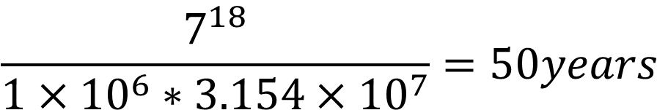
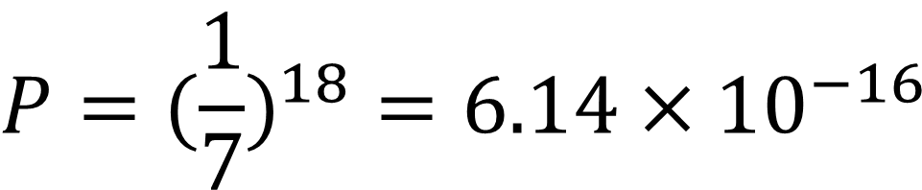
Why is it so hard‽
The probability that a monkey will correctly spell
“To be or not to be”
$$P=(\frac{1}{7})^{18}=6.14×{10}^{−16}$$
With 1 million monkeys each typing a word per second we will be searching for
$$\frac{7^{18}}{1×{10}^{6}∗3.154×{10}^{7}}=50years$$

Slide 14
Search Space
D3
1111
P2
110
111
D1
P1
010
011
D2

